Slide 1

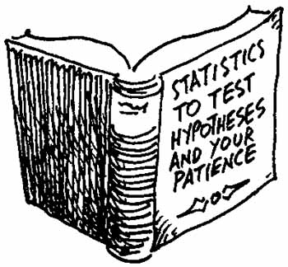
Testing Statistical Hypothesis
Chapter 7 Part 1
Dr. Abolfazl Saghafi
Assistant Professor of Statistics & Data Science
Data Science Program Director
Notes:
We will proceed this subject with a story, a fairytale!
Understanding the provided definitions, notations and materials is essential for solving testing problems and daily decision-making in general.

Slide 2




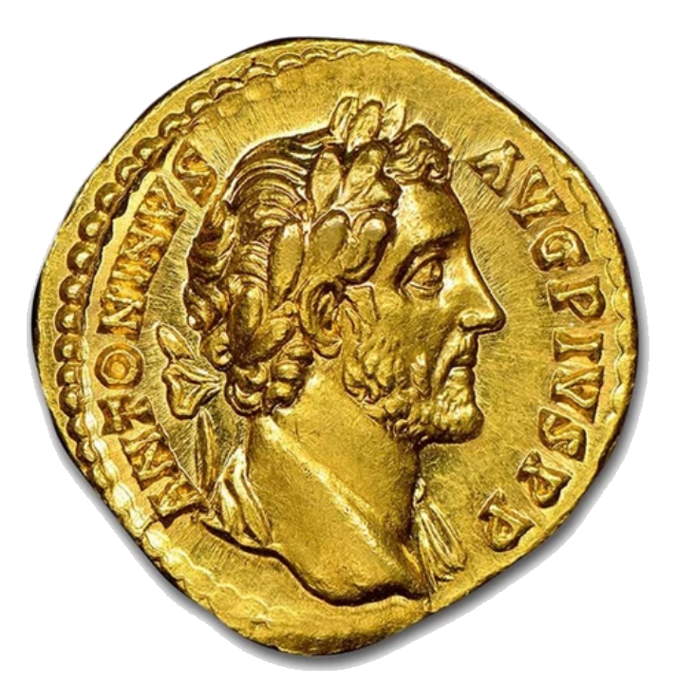
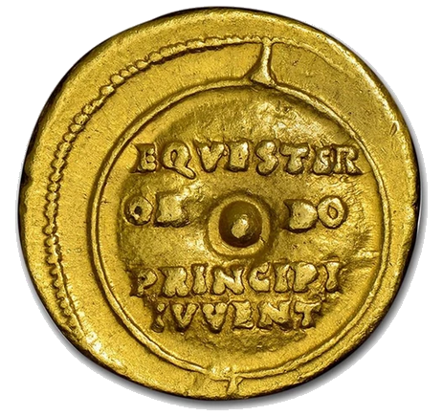
Notes:
A mad king decides to find a smart, brave, and lucky man for his only daughter. Smart and brave are reasonable characteristics but why lucky! Anyways, the king orders to forge a special coin with head/tail sides and let any suitor to flip it 5 times to decide if the coin is fair or slightly biased toward showing head.
If the suitor gets it correctly, he wins the heart of the bride, and he gets to be the future king of the seven lands; otherwise death will be his fate. If you were the suitor, what strategy would you take? How do you approach such a problem?

Slide 3
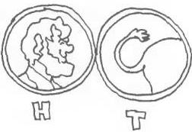

Introduction
A mad king decides to find a smart, brave, and lucky man for his only daughter.
He orders to forge a special coin with head/tail sides and let any suitor to flip it 5 times to decide if the coin is fair or slightly biased toward showing head.
If the suitor gets it correctly, he wins the heart of the bride; otherwise death will be his fate.
If you were the suitor, what strategy would you take?
Notes:
A mad king decides to find a smart, brave, and lucky man for his only daughter. Smart and brave are reasonable characteristics but why lucky! Anyways, the king orders to forge a special coin with head/tail sides and let any suitor to flip it 5 times to decide if the coin is fair or slightly biased toward showing head.
If the suitor gets it correctly, he wins the heart of the bride, and he gets to be the future king of the seven lands; otherwise death will be his fate. If you were the suitor, what strategy would you take? How do you approach such a problem?

Slide 4
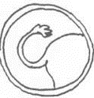

What could happen?
Lets start by showing all the possible outcomes in the experiment of five times flipping this special coin. We should decide if the chance of head is equal to tail OR the chance of head is greater than tail. For which of the following results would you say that the coin is biased?
0H
3H
1H
4H
2H
5H
Notes:
Lets start by showing all the possible outcomes in the experiment of five times flipping this special coin. We should decide if the chance of head is equal to tail OR the chance of head is greater than tail. For which of the following results would you say that the coin is biased?
If you see 0H, it makes sense more sense that the coin is biased and you’re extremely unlucky. If 5H appears, it makes more sense that the coin is biased, BUT it could be a fair coin and you have been extremely lucky! We will statistically formulate the overall decision making process and point out some important issues you need to consider in your decisions. Afterall, your life is on the line!

Slide 5
Statistical Hypothesis
Population
Sample
The New Oxford Dictionary gives the following definition of a "Hypothesis":
A proposition put forward merely as a basis for reasoning or argument, without any assumption of its truth.
A parameter is a numerical measure that describes the characteristic of the population.
A statistic is a numerical measure that describes the characteristic of a sample.
A STATISTICAL HYPOTHESIS however, is something different.
Statistical Hypothesis is an assumption about a population parameter which may or may not be true.
Notes:
The New Oxford Dictionary gives the following definition of a Hypothesis: “A proposition put forward merely as a basis for reasoning or argument, without any assumption of its truth“. A STATISTICAL HYPOTHESIS however, is something different. It is an assumption about a population parameter which may or may not be true.
Hope you still remember what population parameter is; it is VERY important to know that and to recognize parameters (μ, σ², p) from sample estimations ($\overline{x}$, $s^{2}$, $\hat{p}$).

Slide 6
Examples
Ex1. A pharmaceutical company that produces a certain drug claims that it is 80% effective in reducing blood pressure. Assumption is made about what population parameter?
Ex2. Channel 5 news states that children in the United States watch an average of 3 hours of TV per week. What population parameter is under investigation here?
Ex3. A car company claim that their new electric car can run on average at least 200 miles after fully charged. What is the parameter under investigation?
Notes:
What population parameter is under investigation in each example? Write it down in the given boxes. What about the king’s example?
Answers:
p: proportion of drug effectiveness
mu: average time spent watching TV in US children
mu: average car mileage after fully charged

Slide 7
Null / Alternate Hypotheses
Read H₀ as as "H-null", “H-naught”, or "H-zero"
Null Hypothesis denoted by H₀ states the initial claim or the statement under investigation.
Our goal is to decide based on data, which of the H₀ or H₁ is true.
Write down the null hypothesis of our examples:
As a general rule, we stick to H₀ until data shows that it cannot be true.
Alternate Hypothesis denoted by H₁ is the claim or hypothesis that will be accepted if the null hypothesis is rejected. It is USUALLY the opposite of H₀
Notes:
We formulate a testing problem by defining null and alternate hypothesis. Null Hypothesis denoted by H₀ (Read H₀ as as "H-null", “H-naught”, or "H-zero") states the initial claim or the statement under investigation. Answers: p=0.8, μ=3, μ≥200
Alternate Hypothesis denoted by H₁ is the claim or hypothesis that will be accepted if the null hypothesis is rejected. It is usually the opposite of H₀ but generally depend on the problem. VERY IMPORTANT: H₀ and H₁ could switch places. Answers: p≠0.8, μ≠3, μ<200
Our goal is to decide based on data, which of the H₀ or H₁ is true. They both cannot be true at the same time since they are exclusive or disjoint. We generally stick to H₀ until data shows that it cannot be true.

Slide 8
Type I and II Errors
Type I error is known as the false positive
Type II error is known as the false negative
Based on the actual situation and the decision we make, we might commit any of the following two types of errors
Fact
H₀ is True
H₀ is False
We commit
Type I Error
Reject H₀
Correct Decision
Decision
We commit
Type II Error
Fail to Reject H₀
Correct Decision
Notes:
Since we are deciding on correctness of H₀ or H₁ using sample data not the whole population data, our decision comes with a risk, we might commit any of the following two types are error. These errors are conditional statements. Type I error is Rejecting H₀ (Decision) when H₀ is True (Fact) while Type II error is Failing to Reject H₀ (Decision) when H₀ is False (Fact).

Slide 9
Example
Consider a criminal trial; a defendant is considered not guilty as long as his or her guilt is not proven. Fill out the blank spaces with a correct statement from the pull regarding testing statistical hypothesis.
Fact
Guilty - Not Guilty - Type I Error - Correct Decision - Type II Error - Correct Decision
H₀ is True
H₀ is False
Reject H₀
H₀:
Decision
Fail to Reject H₀
H₁:
Notes:
You should be able to answer this, if not, read the past slides carefully to figure out the answer

Slide 10
Probability Rules
α is the same concept in confidence intervals known as significance level.
We can measure the chance of type I and II errors using conditional probability.
Type I Error is committed when we incorrectly reject a true null hypothesis; that is we reject H₀ when in fact it is true.
The probability of such error is shown by α and can be computed by:
α = P( Reject H₀ | H₀ is True )
Type II Error is committed when we fail to reject a false null hypothesis; that is we accept H₀ when in fact it is false.
The probability of such error is shown by β and can be computed by:
β = P( fail to Reject H₀ | H₀ is False)
Notes:
We can measure the chance of type I and II errors using conditional probability.

Slide 11
Power and Confidence
There are two more probabilities in our table of errors that compliment α and β.
The probability of not committing a Type II Error is called the power of the test, shown by γ, it is correctly detecting a false null hypothesis
γ = Power = 1-β = P( Reject H₀ | H₀ is False)
The probability of Type I Error which we show by α is the same significance level α we had in the confidence intervals. Thus, confidence level is
(1-α) = P( fail to Reject H₀ | H₀ is True)
Notes:
There are two more probabilities in our table of errors that compliment α and β.

Slide 12


The Story Follow Up
The mad king orders to forge a special coin with head/tail sides and let any suitor to flip it 5 times to decide if the coin is fair or slightly biased toward showing head.
1. What population parameter is under test here?
2. Write down the Null and Alternate Hypothesis.
3. What is our testing tool?
4. When should we reject H₀?
5. Perform the experiment and make a decision.
Notes:
Answer:
1. p: chance of showing head in THE coin
2. H₀: p=0.5 Vs H₁: p>0.5 (lets say p=0.6)
3. X: the number of heads in 5 times flipping the coin $\sim Bin(n=5, p)$
4. When X >= c where c is a threshold we need to decide on
Lets try different values of c and see their errors

Slide 13




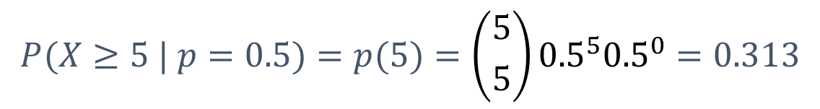

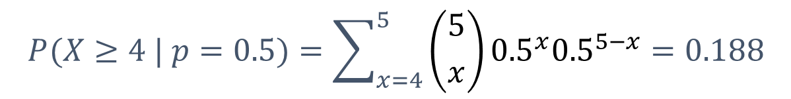

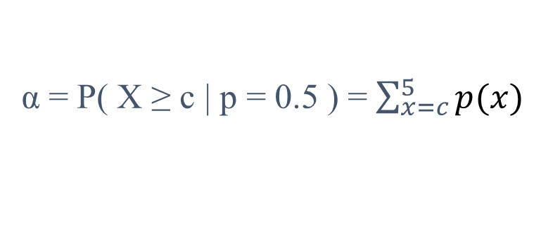
Alpha
2
1
3
4
5
$$H_{0}:p=0.5$$
$$p$$
$$X$$
RR: $(X≥c)$
$$x$$
Lets see the effect of different values of c on α
$$H_{1}:p=0.6$$
0 1 2 3 4 5 6
Type I Error and its probability α = P( Reject H₀ | H₀ is True )
α = P( X ≥ c | p = 0.5 ) = $\sum_{x=c}^{5}{p(x)}$
$$P(X≥4 | p=0.5)=\sum_{x=4}^{5}{\left({5 \atop x}\right){0.5}^{x}{0.5}^{5−x}}=0.188$$
c = 4:
$$P(X≥5 | p=0.5)=p(5)=\left({5 \atop 5}\right){0.5}^{5}{0.5}^{0}=0.313$$
c = 5:
Notes:
You will not be asked to compute alpha and beta, understanding them however is crucial for any statistical testing

Slide 14
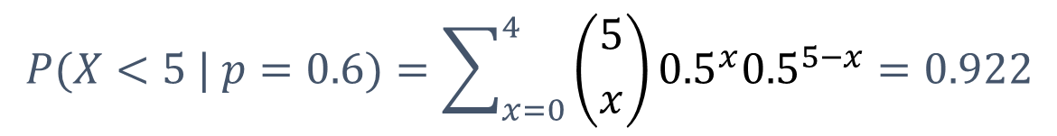
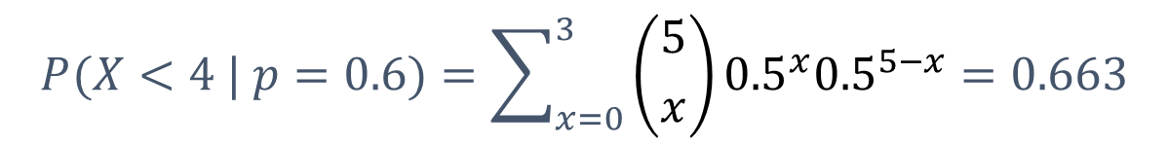
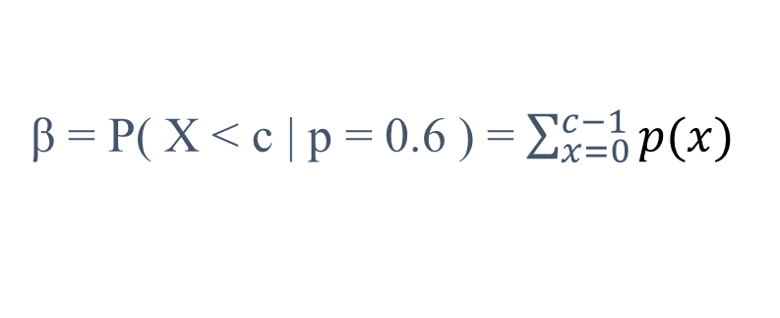
Beta
2
1
3
4
5
$$H_{0}:p=0.5$$
$$p$$
$$X$$
RR: $(X≥c)$
$$x$$
Lets see the effect of different values of c on β
$$H_{1}:p=0.6$$
0 1 2 3 4 5 6
Type II Error and its probability β = P( fail to Reject H₀ | H₀ is False)
β = P( X < c | p = 0.6 ) = $\sum_{x=0}^{c−1}{p(x)}$
$$P(X<4 | p=0.6)=\sum_{x=0}^{3}{\left({5 \atop x}\right){0.5}^{x}{0.5}^{5−x}}=0.663$$
c = 4:
$$P(X<5 | p=0.6)=\sum_{x=0}^{4}{\left({5 \atop x}\right){0.5}^{x}{0.5}^{5−x}}=0.922$$
c = 5:

Slide 15
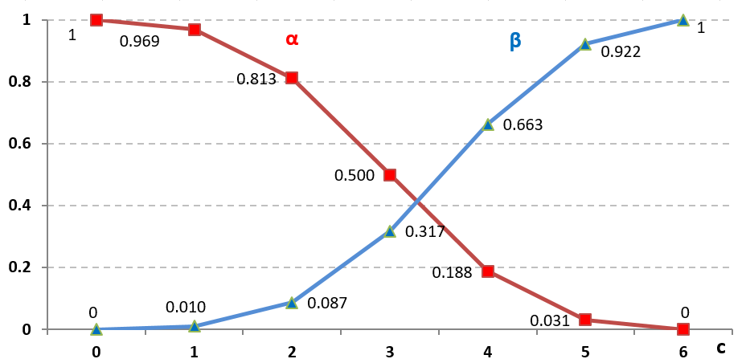

Wedd or Head
This graph shows different values of 𝜶 and 𝜷 for possible values of the threshold “c”.
What is your strategy in this situation?
RR: $(X≥c)$
Notes:
Suppose the punishment for Type I error (H0 Rejection by mistake) is execution and for Type II error (H0 Acceptance by mistake) is 20 years imprisonment. What would be your strategy?
How do you think you can improve your chance?
Type I error is usually a more important error, that is how we design the testing in the first place. A typical strategy is to control α to an acceptable level, usually 5%, then find the threshold “c” that has a minimum β.

Slide 16

Practice Problems Part 1
In the following problems, clearly write down the
a. Parameter under claim b. Null and Alternate Hypothesis
1. Given the opportunity to vote on a referendum to legalize marijuana in Pennsylvania, at least 60% of the voters would vote to pass the legalization.
2. A Packaging Company produces boxes out of cardboard and claim that the boxes have a specified weight of 30 oz.
3. A mayor claims that at least 75% of all government entrances facilitates disabled individuals. A civil rights group disputes this claim and argues that the city discriminates against disabled groups.
Notes:
Answers are in Ch7 Practice Problem Solutions

Slide 17
Practice Problems Part 1
5. Consider a drug test. A new drug is considered not effective before passing certain lab tests. State the H0 and H1, then fill out the table with a correct statement from the pull regarding testing statistical hypothesis.
Effective Drug - Not Effective Drug - Type I Error - Correct Decision - Type II Error - Correct Decision
Decision
Effective
Not Effective
Effective
Fact
Not
Effective
Notes:
Answer is not provided, you should be able to confidently figure it out after going over the slides.

